Slide 1
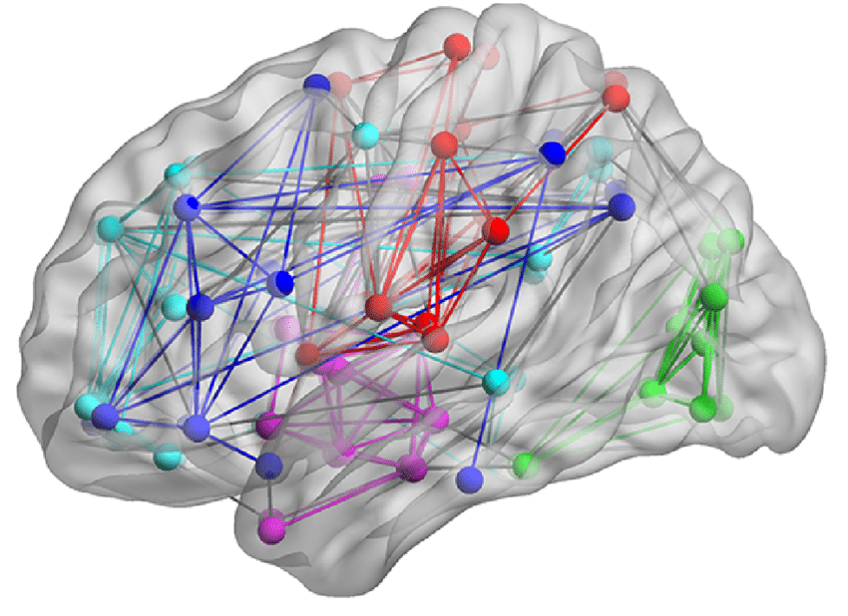
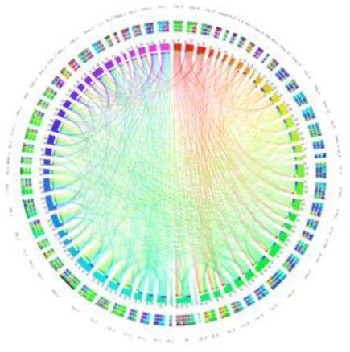
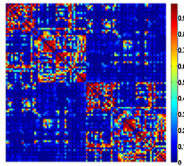
Brain Network
Brain connectome
Brain graph
etc.

Slide 2


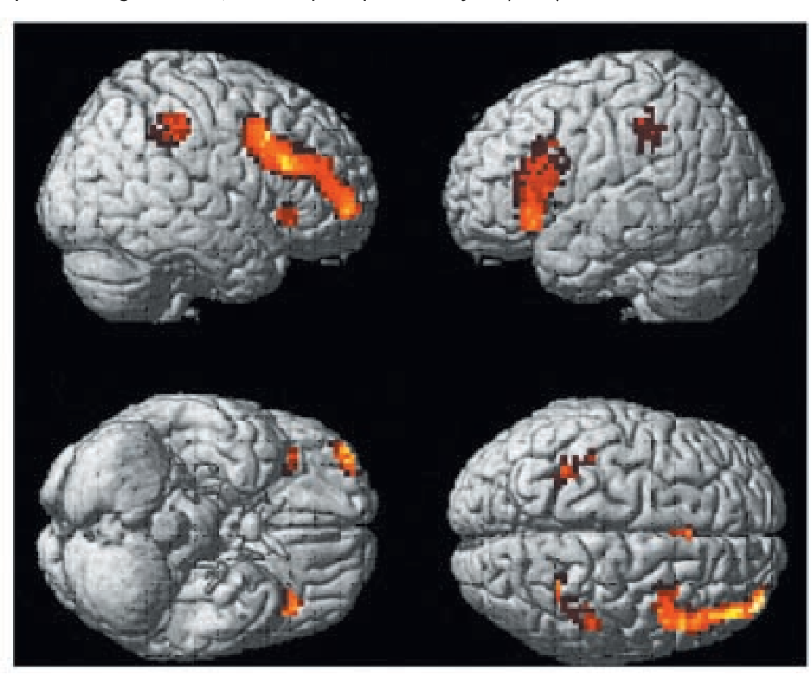
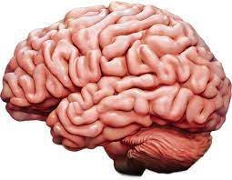
Why brain network?
Notes:
Pixel
Voxel

Slide 3
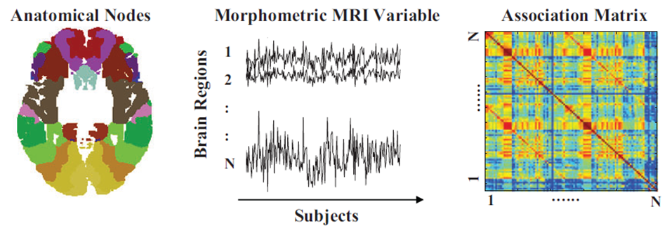
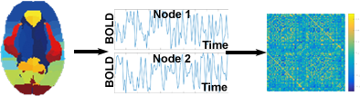
Brain Network
1. Structural MRI--- correlation of anatomy measures between nodes
1
M
2. Functional MRI--- correlation of the time courses between nodes
Notes:
(one network per group)
(one network per subject)

Slide 4
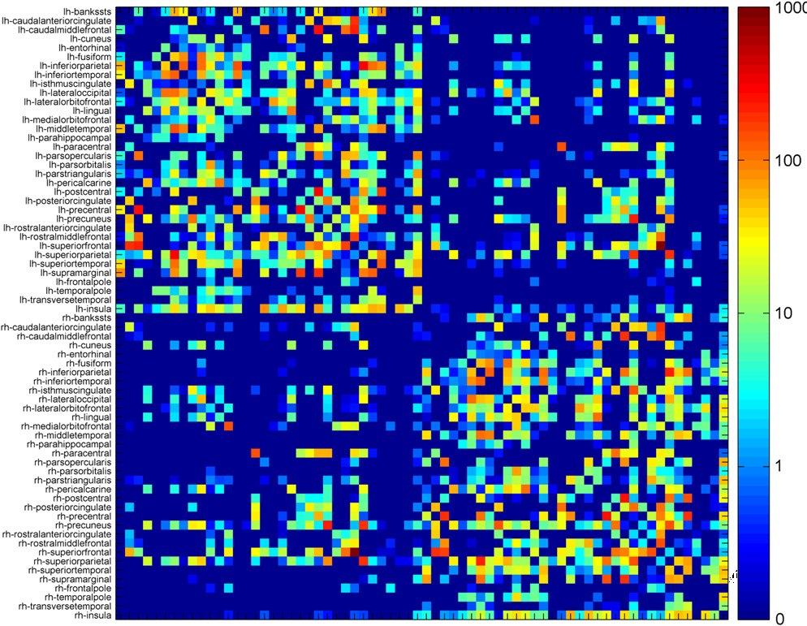

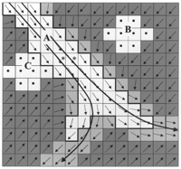
Brain Network (Cont.)
3. Diffusion-weighted MRI--- the number of streamline connecting nodes
Will talk more on this in later signal modeling lecture
Notes:
(one network per subject)

Slide 5
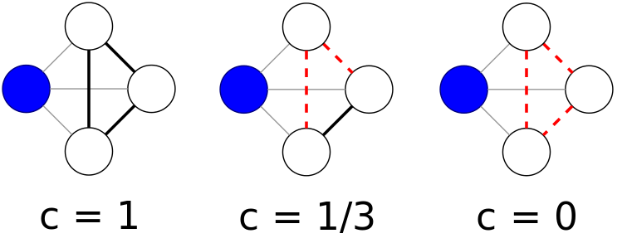
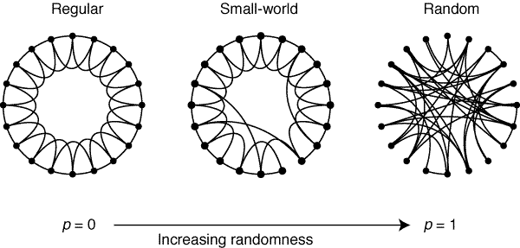
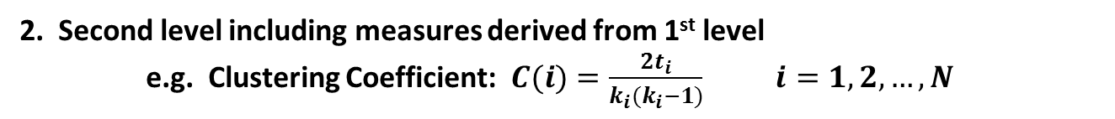
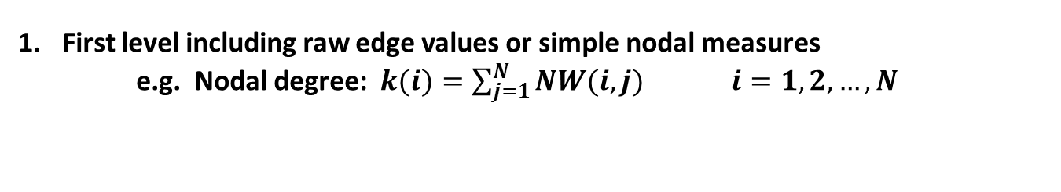
Overview for standard network analyses
First level including raw edge values or simple nodal measures
e.g. Nodal degree: $k(i)=\sum_{j=1}^{N}{NW(i,j)}$ $i=1,2,…, N$
2. Second level including measures derived from 1st level
e.g. Clustering Coefficient: $C(i)=\frac{2t_{i}}{k_{i}(k_{i}−1)}$ $i=1,2,…, N$
3. Third level including measures derived from 2nd level
e.g. Small worldness: $S=\frac{C/C_{R}}{L/L_{R}}$
Notes:
CC---it quantify the relationship among the neighbors of the node
T_i --- Number of triangles around a node 𝑖,
L: characteristic path lengths

Slide 6
Tools
Brain Connectome Toolbox (BCT)
https://sites.google.com/site/bctnet/

Slide 7
Higher Level Network Analysis
Intrinsic Geometry and Community Structure (next topic)

Slide 8
In-class exercise
Data description:
1) subject_data.mat contains 113x113x9x202, represents
202 subjects’ 9 networks, each network dimension is 113x113
These 9 networks were created using different methods from diffusion MRI data, and in theory they should be pretty consistent since they are from the same subject, however, if you visualize them, you will see the differences.
2) Subj_information_4_students.xlsx contains
Subject age, sex, and group information
Extract brain network features (select any five measures/features from BCT website), and compare whether 9 networks have any significant differences?

Slide 9
Project 1
Question:
any strategy to justify the unequal numbers between groups (fairness!)
Option 1: explainable
Classify four groups using multi-view brain graph data
Use 10-fold cross validation - 85% for training (you can choose the ratio for verification), and 15% for testing - to do the classification for
Status 1 vs. 2
Status 2 vs. 3
Status 3 vs. 4
Alternative option --- classify these four groups simultaneously
Option 2: Review and present one latest paper on brain graph analysis on disease

